Slide 1
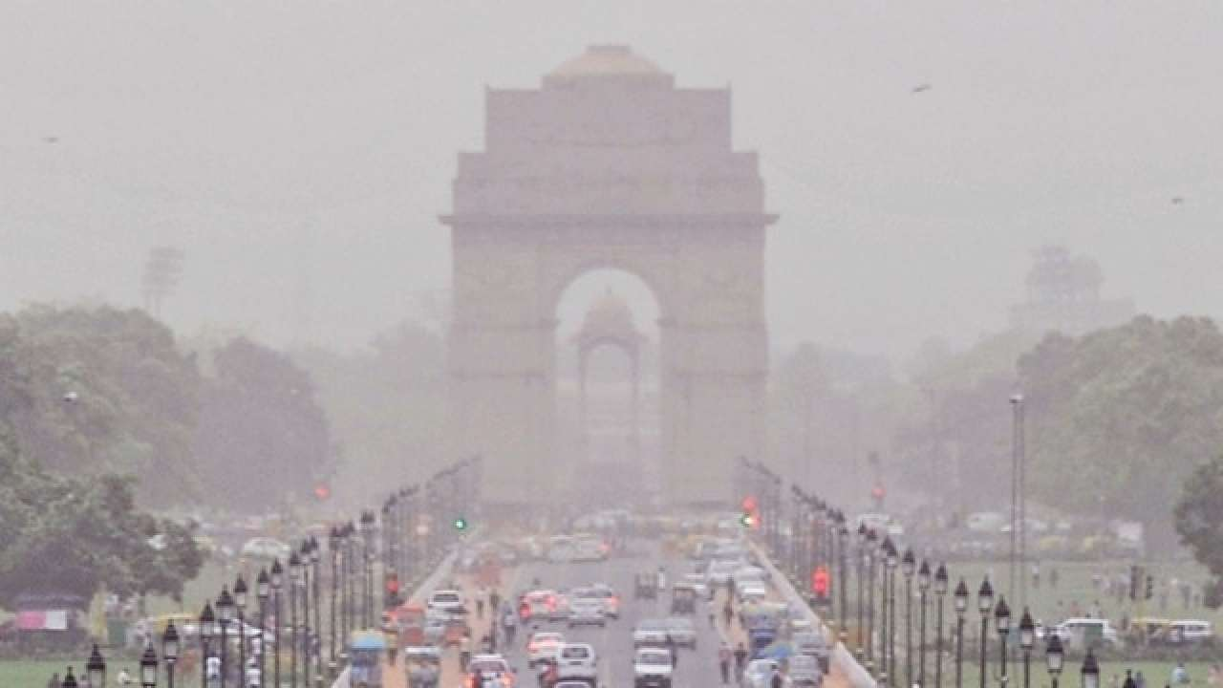
A Picture Is Worth a Thousand Words

Slide 2
OUR TESTBED

Slide 3
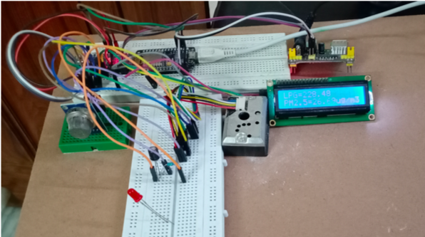
· Sender Station. It consists of the sensors, Arduino 1, ESP8266 and LCD all connected. The main purpose of this module is to collect and send the data to the database

Slide 4
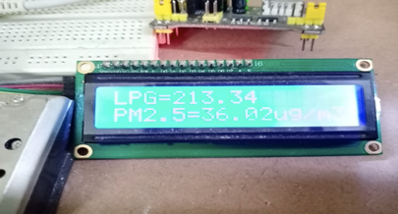
LCD Display

Slide 5
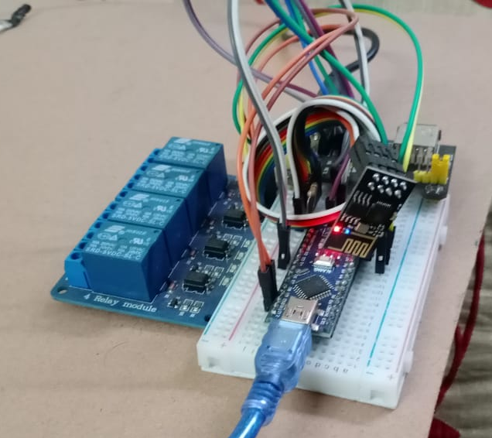
the Receiver Station. It comprises of the ESP8266,Arduino 2 and all the appliances connected to the Arduino 2 using relays. Its main purpose is to read the values from the database and if the threshold crosses a certain value it turns on the appliances

Slide 6
Coming to our Solution

Slide 7
IoT Based Air Quality Monitoring System

Slide 8
The whole design at a glance

Slide 9
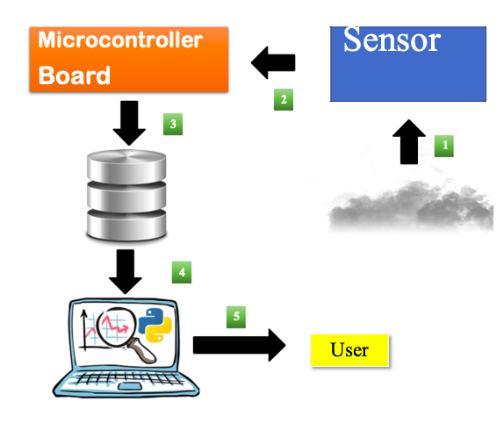

Slide 10
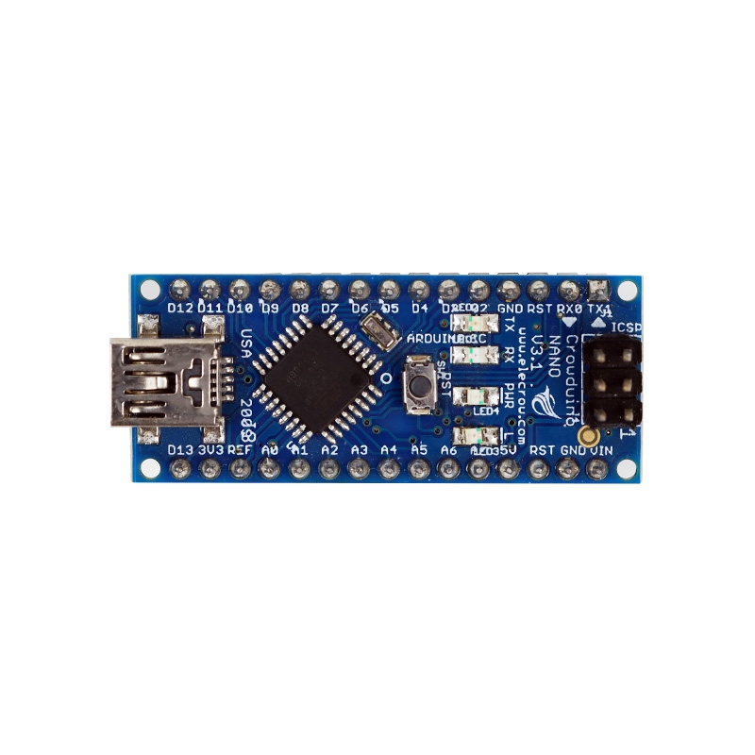
The components used:
Arduino Nano a microcontroller board based on the ATmega328PIt has 14 digital input/output pins 6 analog inputs, a 16 MHz quartz crystal, a USB Connection, power jack. The most important aspect of this is its cost. Its very much affordable and open source

Slide 11
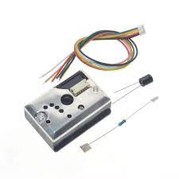
2. PM2.5 GP2Y1010AU0F Dust Smoke Particle Sensor is an infrared emitting diode (IRED) and a phototransistor are diagonally arranged into this device. It detects the reflected light of dust in the air. Especially, it is effective to detect very fine particle like the cigarette smoke. In addition, it can distinguish smoke from house dust by the pulse pattern of the output voltage.[4]

Slide 12
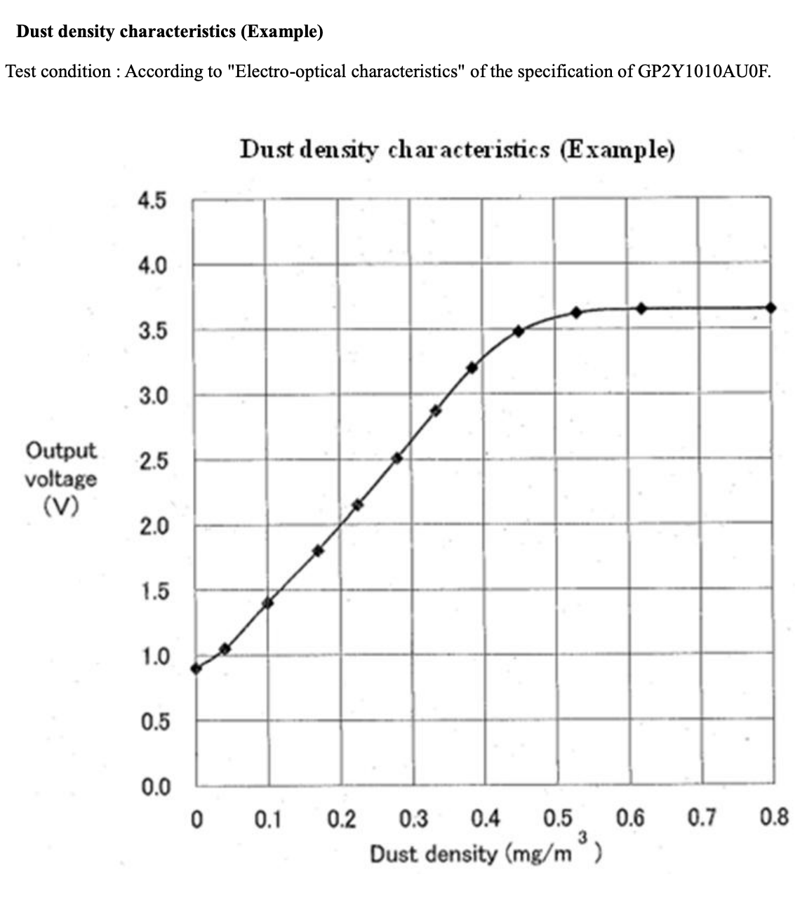

Slide 13
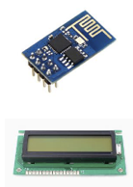
3. ESP8266 WIFI Module is a low-cost Wi-Fi chip with full TCP/IP stack and MCU (microcontroller unit) capability. It runs on 3.3V and gives our system access to Wi-Fi or internet.[6]
4. I2C LCD. This is a basic(16x2) 16 character by 2 line display. Black text on Green background. It is used to indicate the Air and gas values

Slide 14
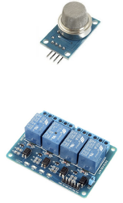
LPG Sensor (MQ2)
This MQ-5 Methane LPG Gas Sensor Module is widely used in gas leakage detecting pieces of equipment in family and industry, are suitable for detecting of LPG, natural gas, town gas, avoid the noise of alcohol and cooking fumes and cigarette smoke.[5]
4-Channel 5V Relay Module
It is 4 Channel Isolated 5V 10A Relay Module. It is able to control various appliances and other types of equipment with large current.

Slide 15
Architecture & Application Flow
The system architecture is classified with respect to sensing, monitoring, and displaying systems. All operations are performed by keeping Internet as the backbone. There are different sensors used in this system. All these sensors produce raw data which will be stored in a central database. This raw information need to be carefully monitored, analyzed and then made into a meaningful
context. If any issues, actions are taken automatically by the system.
We have classified the system in three important aspects like :-

Slide 16
01
02
03
Sender Subsystem
Monitoring System
Receiver Subsystem

Slide 17
Sender SubSystem
01

Slide 18
Sender Subsystem
The Sender station works as follows. There are two sensors, the dust sensor[4] and the LPG gas detector[5]. Both the sensors output a voltage value in the range of 0 to 5 V
depending on the amount of dust particles and the amount of LPG in the air respectively

Slide 19
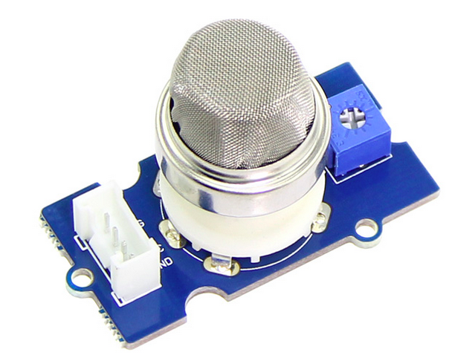
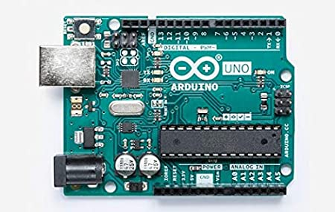
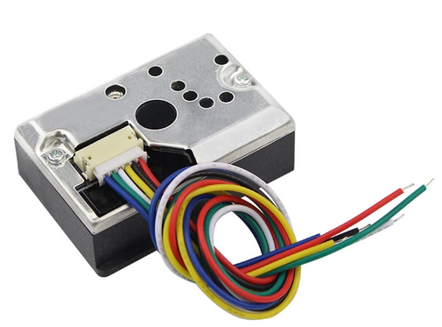
Sender Subsystem

Slide 20
Once the sensors read the data values, it is sent to the ESP8266[6] Node MCU using Serial Communication with a baud rate of 115200.

Slide 21
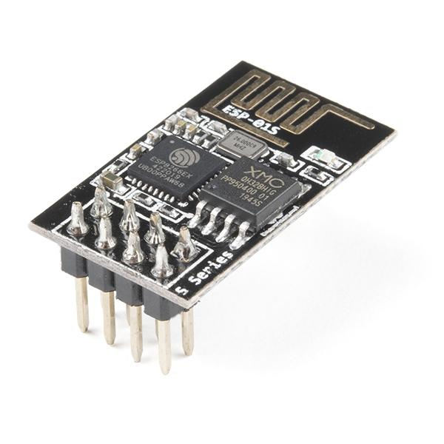

Slide 22
For the Serial Communication, we have used the in-built UART(universal asynchronous receiver-transmitter) protocol in Arduino. UART is a hardware communication protocol that uses asynchronous serial communication with configurable speed

Slide 23
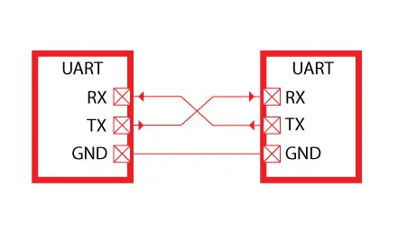
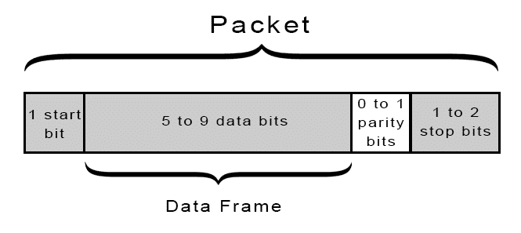

Slide 24
Now when the data has been received by the ESP 8266[6] module, the task remaining is to send the data to the server. ESP for this reason connects to the local Wi-Fi router and makes a HTTP GET request.
ex:
http://192.168.0.3/sendValue.php?sensor_id=1&lpg=34.12&density=%2020.37

Slide 25
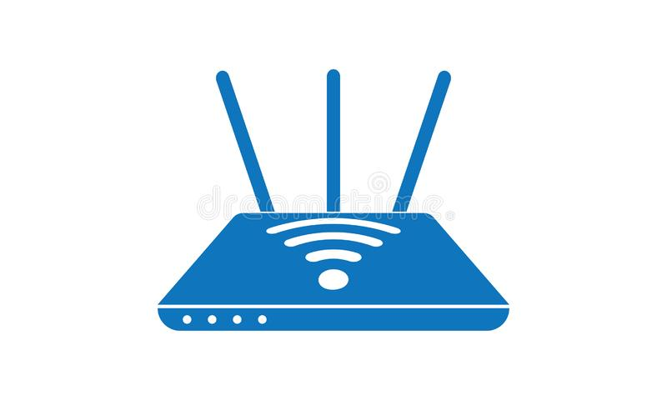

Slide 26
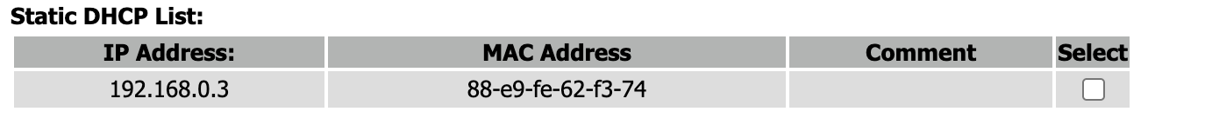
Now this can create many problems. As we are using a home router with a private
network the inbuilt DHCP server may assign different values to the same device at
different times. This means we will have to change the code every time we log in. So to
avoid this we find out the mac address of our server and fix a static IP address
corresponding to the given MAC address. We can also do this for the individual
ESP8266 WIFI modules if needed.

Slide 27
Finally the HTTP request is routed to the Server which in turn Saves the values in the MySql Database Server. For this we have taken help of PHP to run the Scripts

Slide 28


Slide 29


Slide 30
Overall
Sender SubSystem

Slide 31
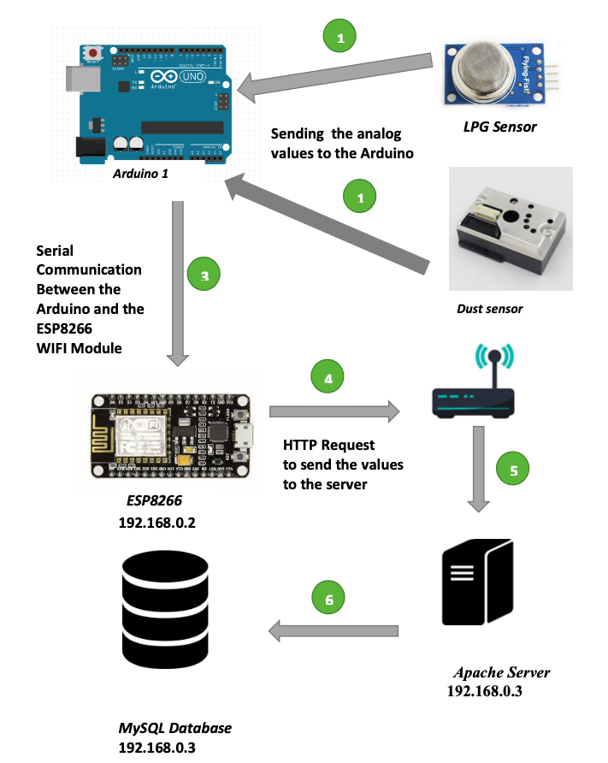

Slide 32
Monitoring SubSystem and BackEnd
02

Slide 33
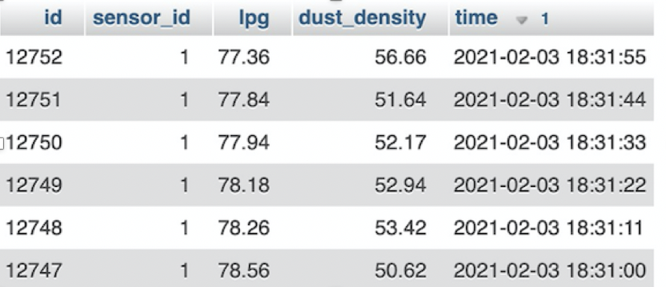
In the following, we will be looking at the role of servers and databases
For our system, we used MySQL database for receiving sensor data. Now once the request reaches the Apache Server and the server is connected, it looks for the php file, were the PHP file redirects to a MySQL database, where the sensor
information are stored. The database consists of 1 table that has 5 attributes.

Slide 34
Receiver SubSystem
03

Slide 35
The receiver subsystem comprises the ESP 8266 and Arduino 2 along with the smart switches/relays.
The working of the Receiver station is as follows every 10 seconds the ESP 8266 sends a HTTP request
Ex
http://192.168.0.3/getdata.php

Slide 41
To get the value of the latest 2 entries of the database. This happens by the same procedure discussed above. Once the data is collected, it is sent to the Arduino 2 using UART as discussed earlier. Arduino 2 checks if the data is crossing a certain threshold
or not. If yes it signals the relay with an active low signal of 0V (5 V means off). The appliances such as exhaust and air purifiers turn on and off as needed.

Slide 43
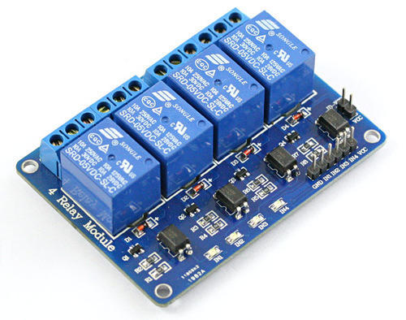

Slide 44
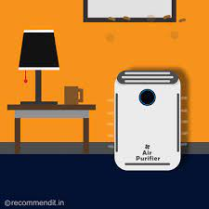
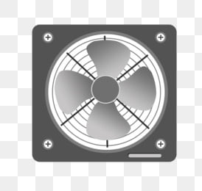

Slide 45
Overall
Receiver SubSystem

Slide 46
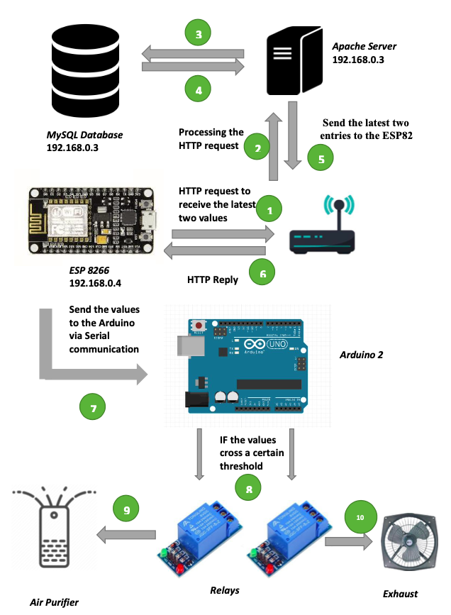

Slide 47
Why do we need clustering?

Slide 48
An anomaly - A deviation from regular pattern

Slide 49
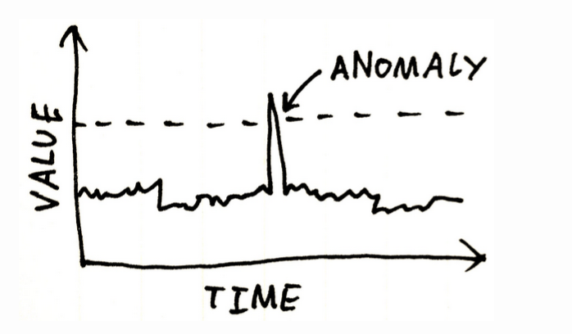
Case 1

Slide 50
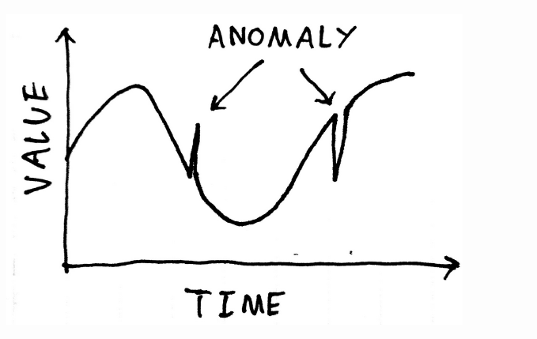
Case 2

Slide 51
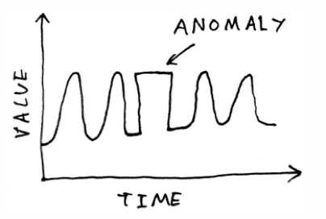
Case 3

Slide 52
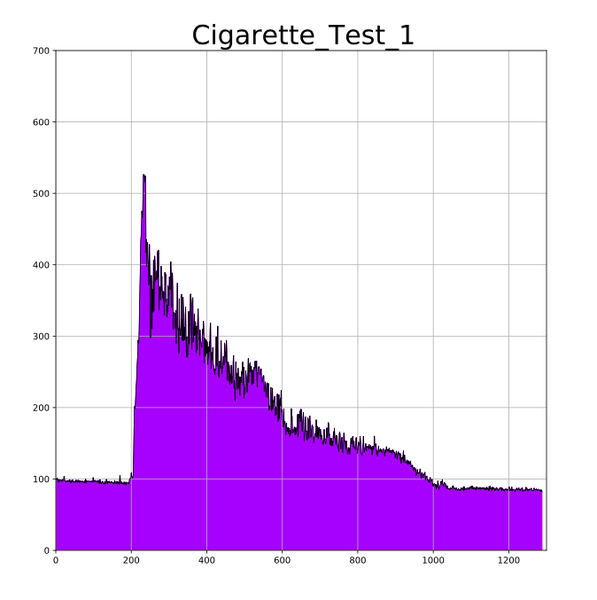
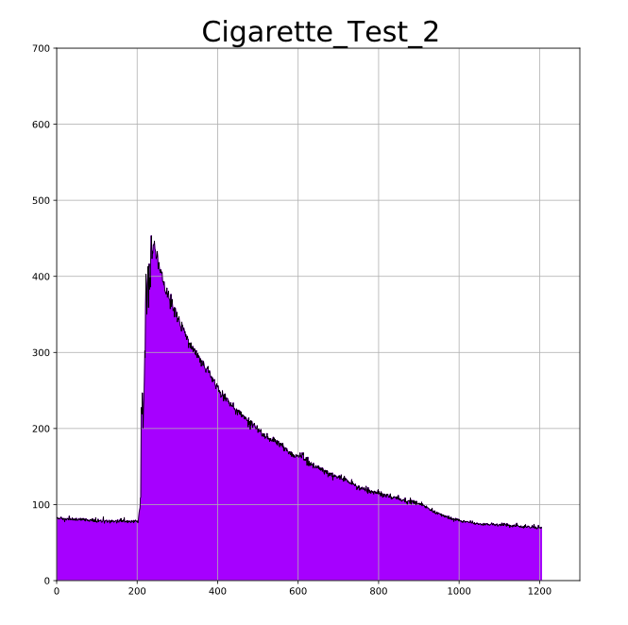
Plot of smoke levels due to cigarette

Slide 53
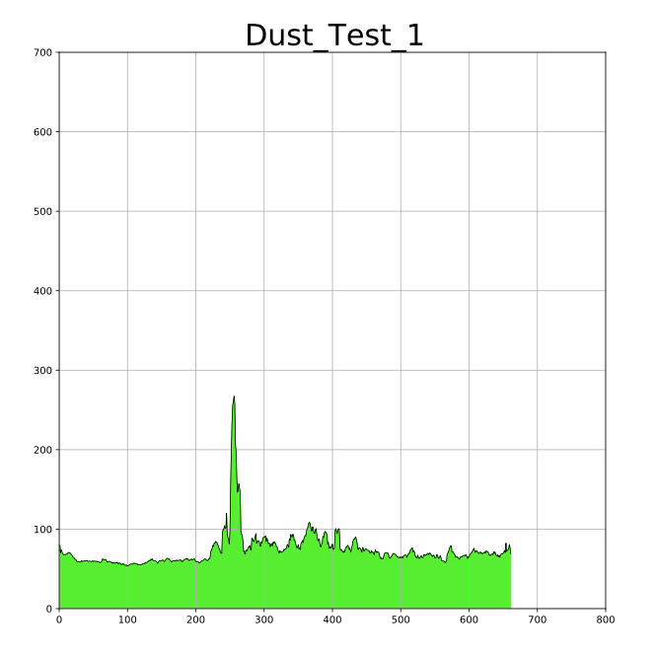
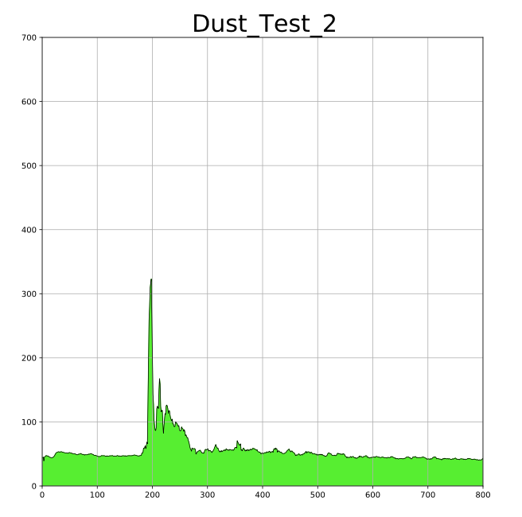
Plot of smoke levels due to cleaning the room

Slide 54
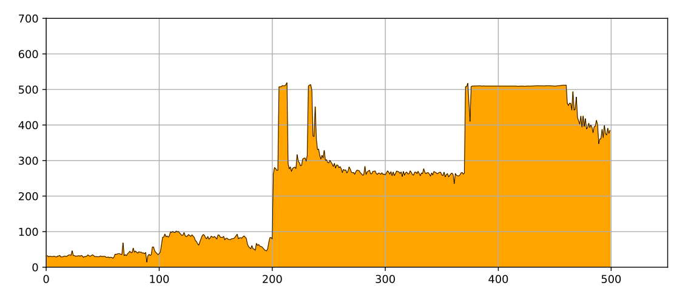
Plot of smoke levels due to fire

Slide 55
To distinguish between smoke due to fire and smoke due to other instances

Slide 56
Clustering

Slide 57
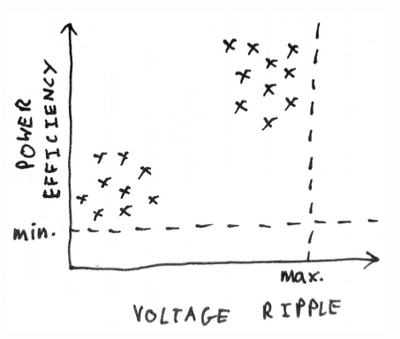
Plot of distribution of capacitors from two different manufacturers

Slide 58
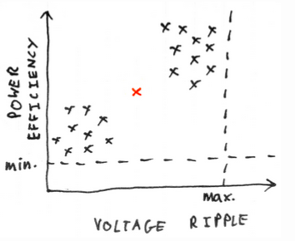
Plot of distribution of capacitors from three different manufacturers

Slide 59
Splitting the waveform into segments

Slide 60
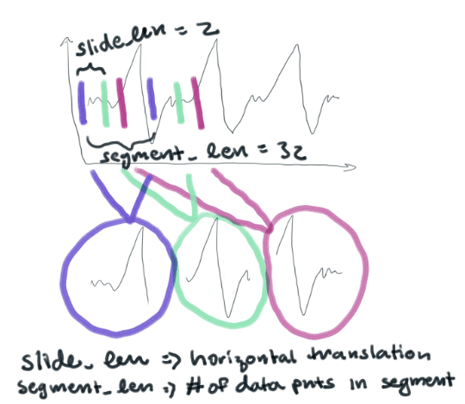
Splitting the waveform into segments to give us separate "samples"

Slide 61
Algorithm at a glance

Slide 62
Training:
Split waveform data into segments of n samples
Each segment representing one point
Determine clustering of segment points, and determine the centres or centroids of the clusters
Cluster centroids provide library of "normal" waveform shapes

Slide 63
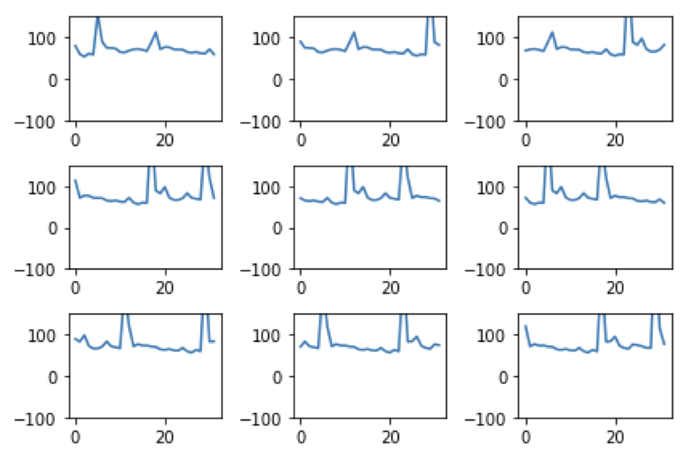
Plot of segments produced

Slide 64
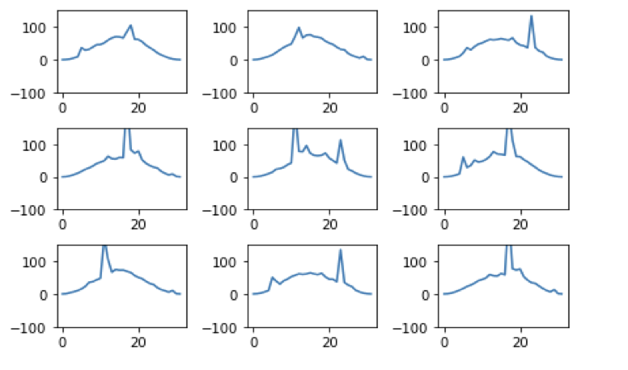
Plot after appending half sine wave into all the segments

Slide 65
Clustering & Reconstruction from Clusters
Using K means clustering algorithm to form clusters
Split the data into overlapping segments
Find the cluster centroid which best matches our segment
Use that centroid as the reconstruction for that segment
Join the reconstruction segments up to form the reconstruction

Slide 66
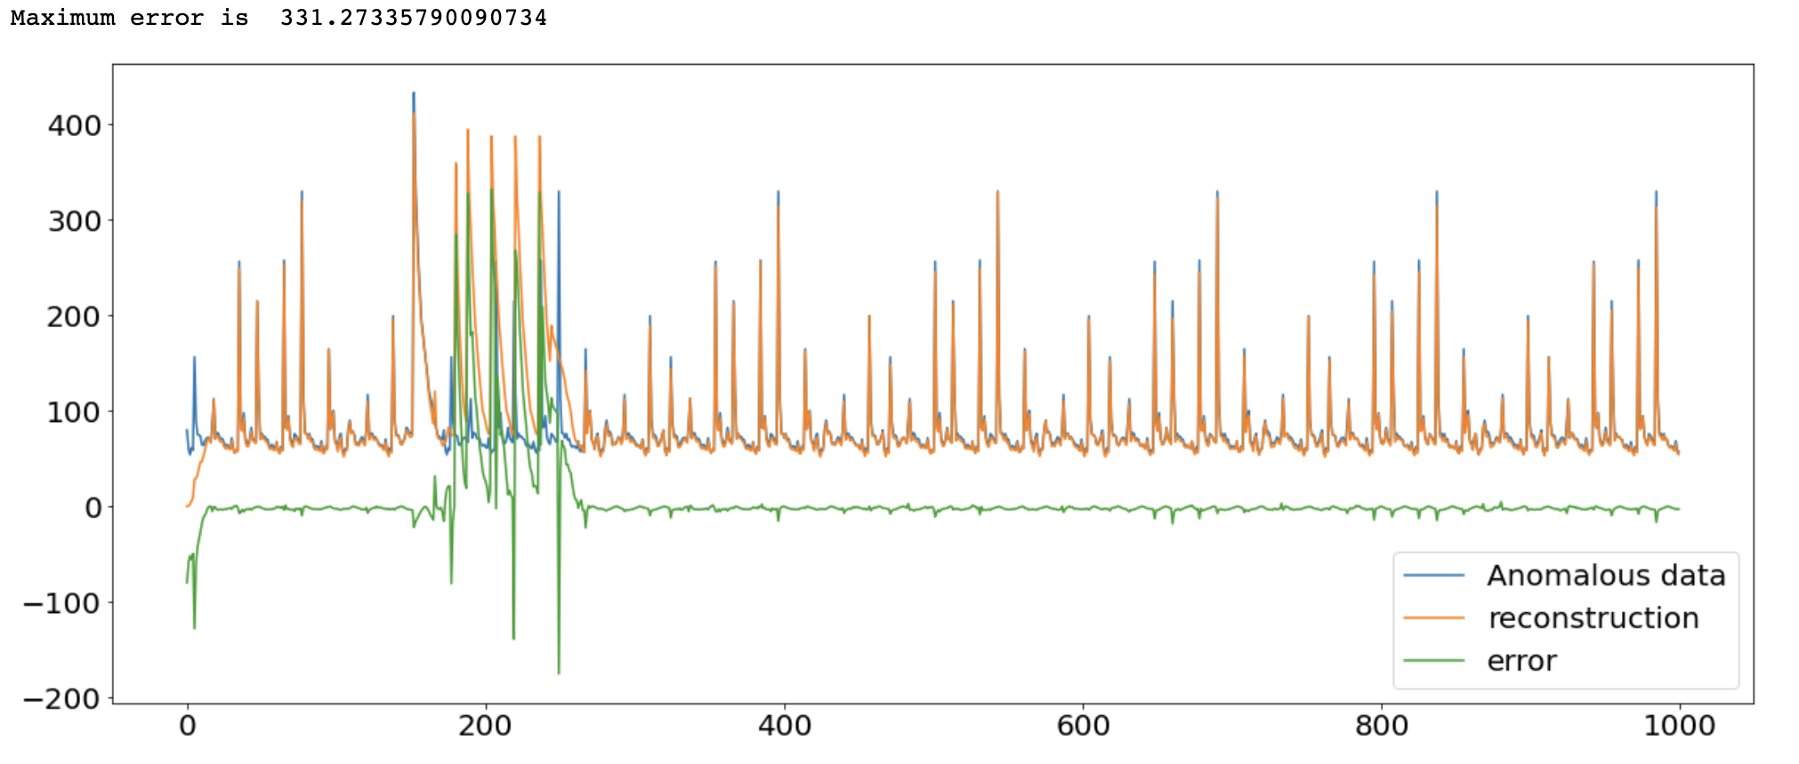
Results

Slide 67
FURTHER IMPROVEMENTS

Slide 68
A GSM module could be added.
The system could be integrated with cloud computing..
An application or website could be developed.
Instead of using Euclidean Distance in K means clustering we could use Distance time warping for getting better results.

Slide 69
References
[1] https://www.who.int/health-topics/air-pollution#tab=tab_1
[2] https://www.iqair.com/us/india
[3] Arduino Nano https://www.electronicscomp.com/arduino-nano-3.0-development-board?search=arduino%20nano
[4] Dust Sensor https://www.electronicscomp.com/gp2y1010au0f-optical-dust-sensor-module?search=dust
[5] LPG Sensor https://www.electronicscomp.com/mq2-flammable-gas-smoke-sensor-module-india?search=MQ2
[6] ESP8266 https://www.electronicscomp.com/ai-thinker-nodemcu-esp8266-development-board?search=ESP8266
[7] I2C LCD Module https://www.electronicscomp.com/1602-blue-lcd-display-with-i2c-interface?search=LCD
[8] 5V Relay https://www.electronicscomp.com/4-channel-5v-relay-module-with-optocoupler?search=5V%20relay
[9] gp2y1010au0f datasheet https://global.sharp/products/device/lineup/data/pdf/datasheet/gp2y1010au_appl_e.pdf
[10] https://github.com/esp8266/Arduino

Slide 70
Thank You

